Slide 1

HOTEL MANAGEMENT SYSTEM
Presented by
Anisha S C(20104009)
Rakshanaa R(20104047)
Yoshitha Sri H A(20104064)
Guided by
Mr.Jayaraj R M.E (PhD)

Slide 2

INTRODUCTION
Hotel management system is a system that allows us to book a room in a hotel for a short stay online.
Most people find it hard to book a hotel during certain times due to less availability of rooms.
Pre-booking is also done to make it easier for people.
Not just booking a hotel but you can also check if any room is available suited to your taste.

Slide 3

ABSTRACT
Hotel Management system is a web-based application.
Interactive GUI and the ability to manage various hotel bookings and rooms make this system very flexible and convenient.
Through this web application one can check the availability of rooms, price, and other details.
Customers can view and book the room online, admin has the power of either approving or disapproving the customer's booking request.

Slide 4

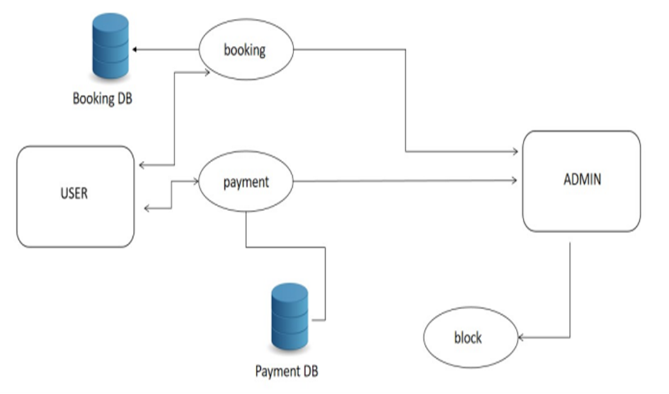
SYSTEM ARCHITECTURE

Slide 5

ER DIAGRAM
id
type
HOTEL
has
ROOMS
name
price
add
room no
ph no
reserve
cash
Id,add
credit
PAYMENT
pay
CUSTOMERS
ph no
e-pay
name

Slide 6

HARDWARE SPECIFICATION
Processor : Intel and AMD processor
Hard disk : minimum 80 GB
RAM : minimum 2 GB
Keyboard : 110 keys enhanced

Slide 7

SOFTWARE SPECIFICATION
Operating System : Microsoft Windows 11
Browser : Chrome Version 108.0.5359.95
Database : MySQL
TOOL USED
XAMPP Server
FRAMEWORK USED
Bootstrap

Slide 8
PROGRAMMING LANGUAGE USED
Html
CSS
JAVA SCRIPT
DATABASE(MySQL)
SERVER(APACHE)
PROGRAMMING LANGUAGE (PHP).

Slide 9
MODULES
Administrator module
User module
Booking module

Slide 10
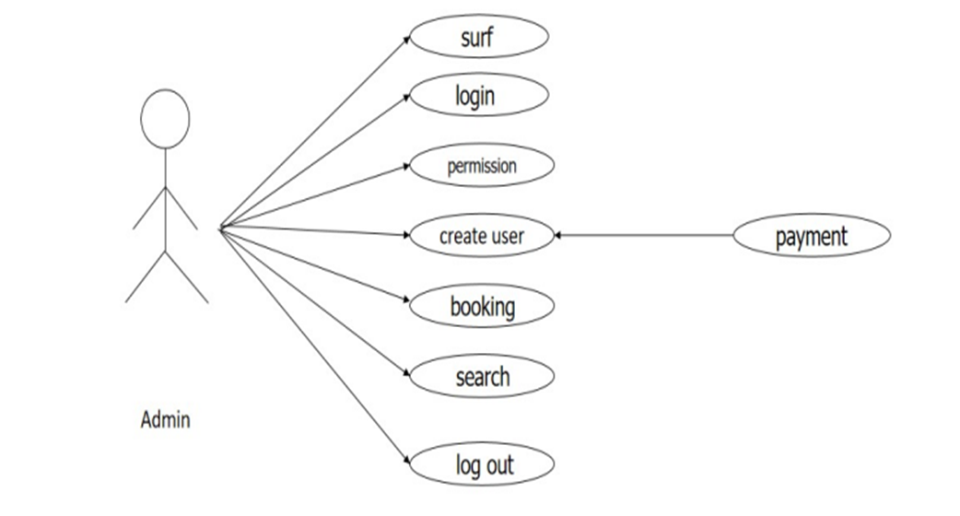
MODULE 1:
Administrator module:

Slide 11
The Functionalities of the Administrator module
The administrator should log in to the system with a unique his/her password and username.
If the username and password are validated, he can gain access to the system.
View the rooms, update and delete the rooms.
Post the special offers, and add a new room to the hotel list.
Insert /View the Availability and Price.

Slide 12
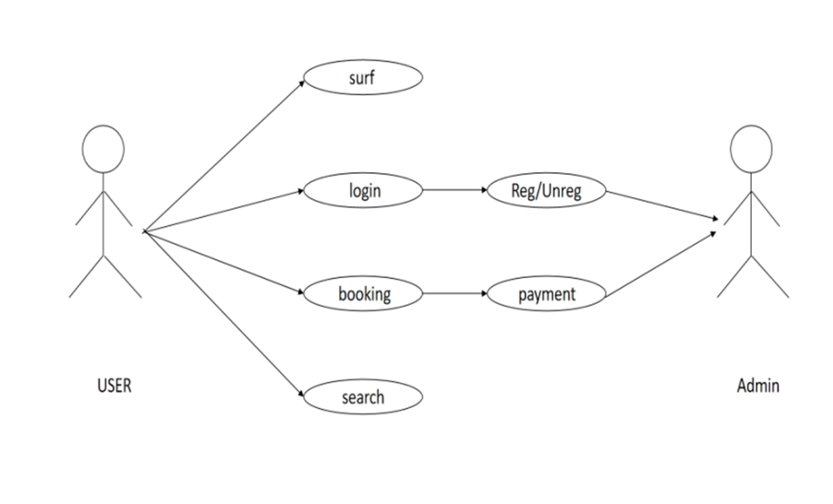
MODULE 2:
User module:

Slide 13
The Functionalities of the User module:
A new User can register with the application by entering his appropriate details.
The User should log in to the system with a unique his/her password and username.
If the username and password are validated, he can gain access to the system

Slide 14
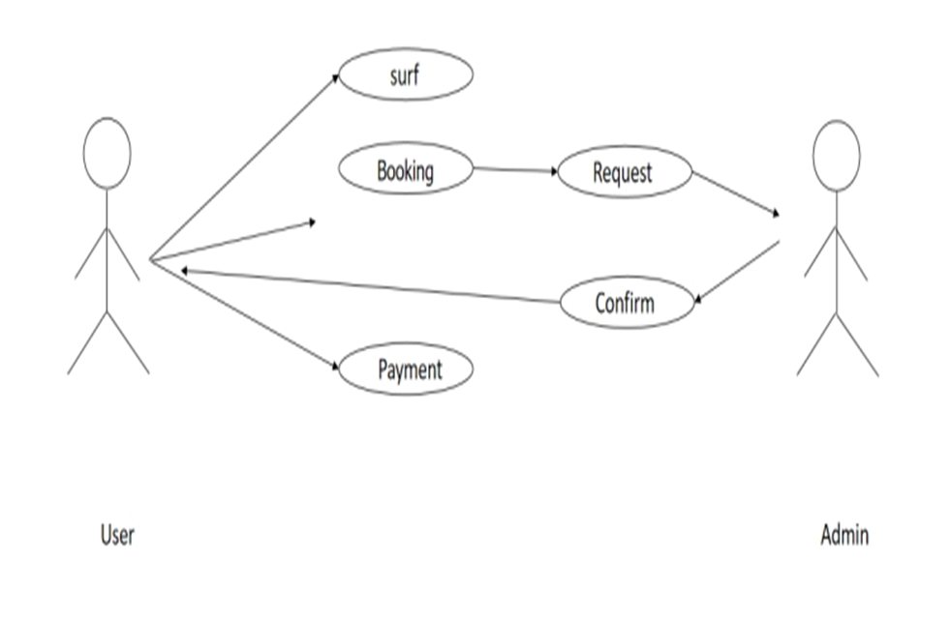
MODULE 3:
Booking module:

Slide 15
The functionalities of Booking:
The user can book the room by making a request if the room is available.
If the room is available then the response is sent to the user and asked to proceed with the payment
The user can confirm his booking by proceeding with the payment.
Payment method can be done as per the user’s interest

Slide 16
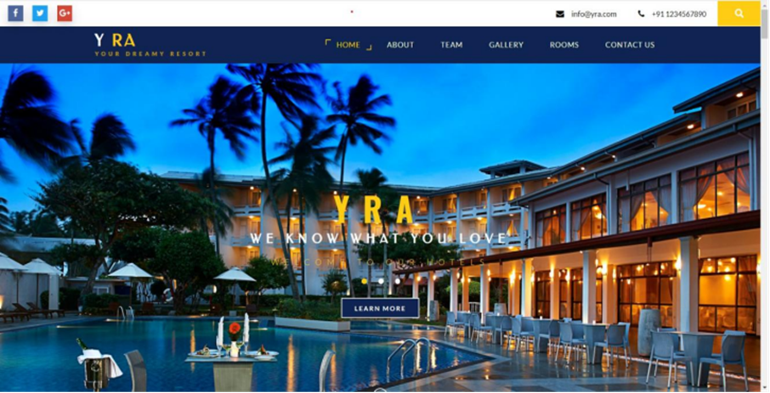
SCREENSHOT

Slide 17
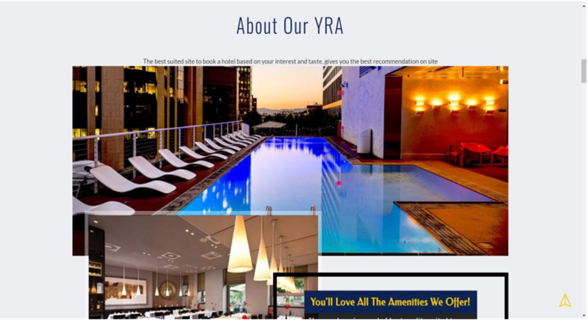
SCREENSHOT

Slide 18

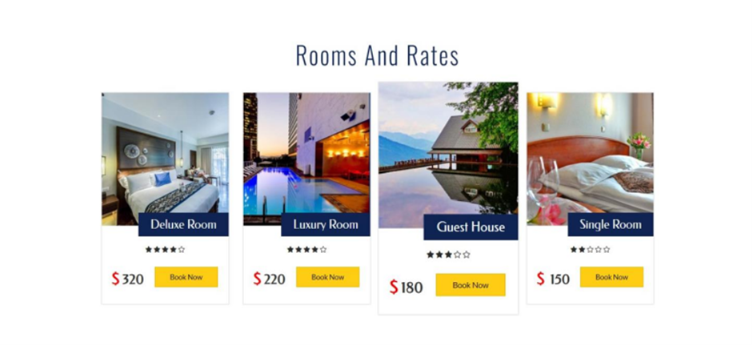
SCREENSHOT

Slide 19
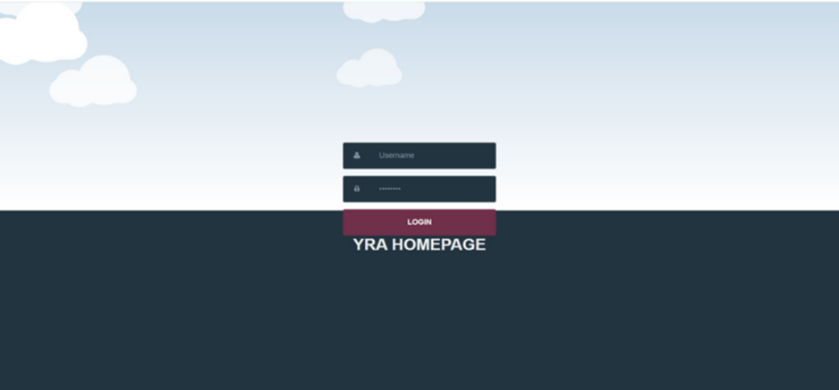
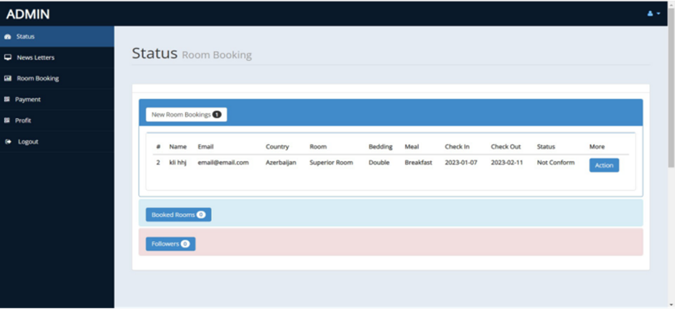
SCREENSHOT

Slide 20
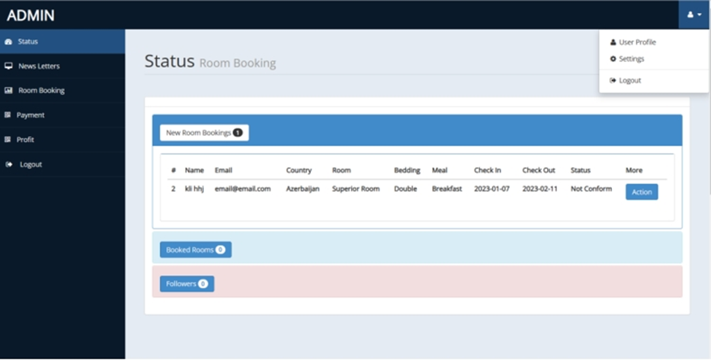
SCREENSHOT

Slide 21
THANK YOU

